Slide 1

Project Title: Multi Sequence Learning with Language Semantic
Module: Software Engineering
Professor: Dr. Damir Dobric and Dr. Andreas Pech
Presented by Team SequenTraid :
Chaitra Bhandari -1504351
Dharani Kumthi - 1502767
Gosi Bhavani - 1502738
30 March 2024

Slide 2
Agenda
Objective
Introduction
Implementation
Results
Conclusion
References

Slide 3
Objective
The objective is to improve the existing Multi-Sequence Learning experiment by automatically processing text data from a file. This includes splitting the data into training and testing sets, training the model with the training data and evaluating prediction accuracy. Additionally, the developed system offers a mechanism for user input for generating text sequences and assessing binary cross-entropy loss during the training phase.

Slide 4

Introduction
Hierarchical Temporal Memory(HTM) inspired by the human brain, is a type of machine learning that tries to understand and predict patterns like our brain does. It organizes information hierarchically and efficiently encodes data, making it good at tasks like spotting anomalies and predicting sequences in real-time data streams. As research progresses, HTM holds promise for even more advanced applications in machine learning.[5][6]
Figure 1 : Neuron. [4]

Slide 5
Sparse Distributed Representations (SDRs): SDRs are information storage and transfer information to feedforward and feedback in HTM.[1]
Encoder: The encoder converts the native format of the data into an SDR that can be fed into an HTM system & is responsible for determining which output bits should be ones, and which should be zeros.[2]
Predictor : It is a component within a system that utilizes learned patterns to forecast the next element in a sequence based on input data.
Classifier: The HTM classifier is a component of the HTM system designed to recognize patterns and make predictions based on sequences of data.
Spatial Pooler : In the SP model neurons learns feedforward connections and form efficient representations of the input. It converts arbitrary binary input patterns into sparse distributed representations (SDRs) using a combination of competitive Hebbian learning rules and homeostatic excitability control.[3]

Slide 6
Implementation
Input data Format
The input data and test data are stored in txt file.
e.g:
You know the day destroys the night Night divides the day Tried to run, tried to hide.

Slide 7
2. Implemented Methods
ReadFileAndConvertToCharList( ) -This function takes a file path as input, reads the file line by line, converts each line into a list of characters, by excluding control characters such as \r, \n, \t etc. And returns the list.
ConvertToAscii ( ) - This method converts a list of characters into a list of ASCII values. It iterates through each character in the input list and converts it to its corresponding ASCII value.
SplitIntoBatches ( ) - This method splits a list of input values into overlapping sequences of a specified batch size and overlap. It iterates through the input list and creates batches of the specified size with the specified overlap.
PredictNextElement ( ) - This method predicts the next element in a sequence based on the input data.

Slide 8
DecodeNumericalSequence ()- This method decodes a list of numerical tokens into a string (sequence of characters). It converts each token (ASCII value) back into its corresponding character.
CalculateCorrectness () - This method checks how well the predicted values match the actual values based on a threshold. For each pair of actual and predicted values, if the difference is within the threshold, it considers the prediction correct (assigned as 1); otherwise, it's incorrect (assigned as 0)
CalculateBinaryCrossEntropy() -This method calculates the binary cross-entropy loss. The binary cross entropy values for each prediction are aggregated, with correct predictions assigned a value of 0 and incorrect predictions a value of 1. Subsequently, the total binary cross-entropy is calculated by dividing the sum of these values by the total number of correctness counts.

Slide 9
var correctness = actualOutputs.Zip(predictedValues, (actual, pred) => Math.Abs(actual - pred) <= threshold ? 1 : 0).ToList();
Compute the binary cross – entropy.
During the learning phase, the binary cross-entropy loss is computed by comparing the active SDRs with predicted values for each cycle. To determine accuracy, the average of the minimum binary cross-entropy values is calculated and then divided by the total number of cycles.
Function CalculateBCE(correctness): bce = 0 foreach c in correctness: if c == 1: bce += 0 else: bce += 1 return bce / length(correctness)
double aveBCE = totalBCE / cycle; double accuracyFromBinaryCrossEntropy = (1 - aveBCE) * 100.0;

Slide 10
Console.Write("Ask Question: "); string inputText = Console.ReadLine(); List<double> asciiVal = new List<double>(); foreach char c in inputText: asciiVal.Add(ConvertToAscii(c)); PredictNextElement(predictor, asciiVal);
Implement the code for prediction.
The user's input or test data from a text file is passed to the predictor, which utilizes the PredictNextElement method to make predictions.

Slide 11
foreach string part in parts : double value = ParseToDouble(part) doubleList.Add(value) generatedResponse = DecodeNumericalSequence(doubleList) if predictedVal == ParseToDouble(tokens2.Last()): totalMatches++ Console.WriteLine($"totalMatches: {totalMatches}") else Debug.WriteLine("Nothing predicted :(") totalPredictions++ accuracy = AccuracyCalculation(totalMatches, totalPredictions) highestAccuracy = GetHighestAccuracyPrediction(accuracy, maxAccuracy, generatedResponse)
Calculate the accuracy of predictions and output the prediction with the highest accuracy.
The accuracy is calculated based on the number of successful matches between predicted and total predictions. The output is determined by selecting the string with the highest accuracy from all the predictions made.

Slide 12
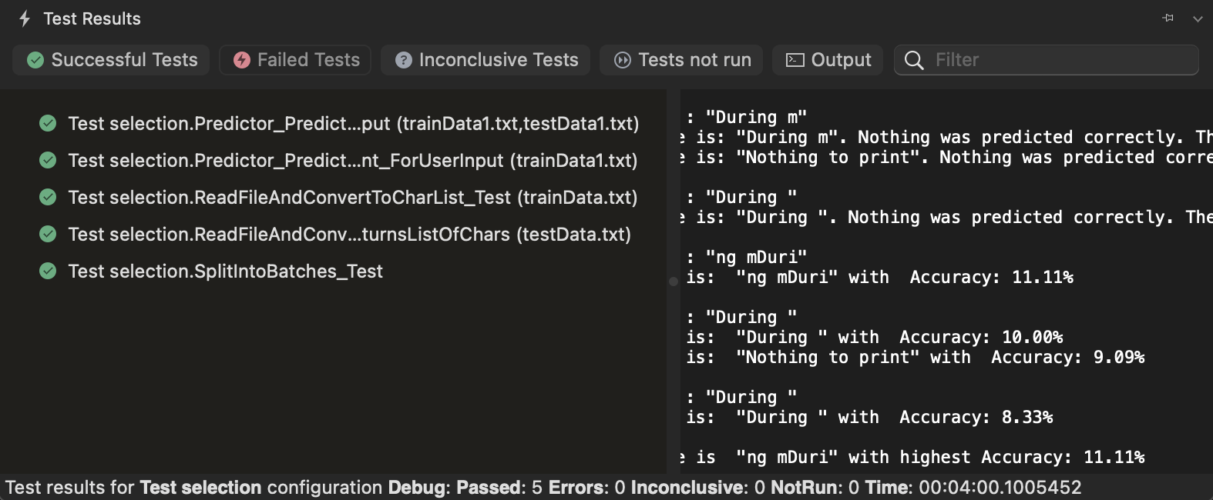
Unit Test Results
Figure 2: Unit Test of The MSL Model
The MS Unit Test framework is employed to design test cases for evaluating Multi-Sequence Learning (MSL) models that integrate language semantics. These test cases are conducted using a small dataset to train and predict accuracy, owing to longer time consumption of the underlying processes.

Slide 13
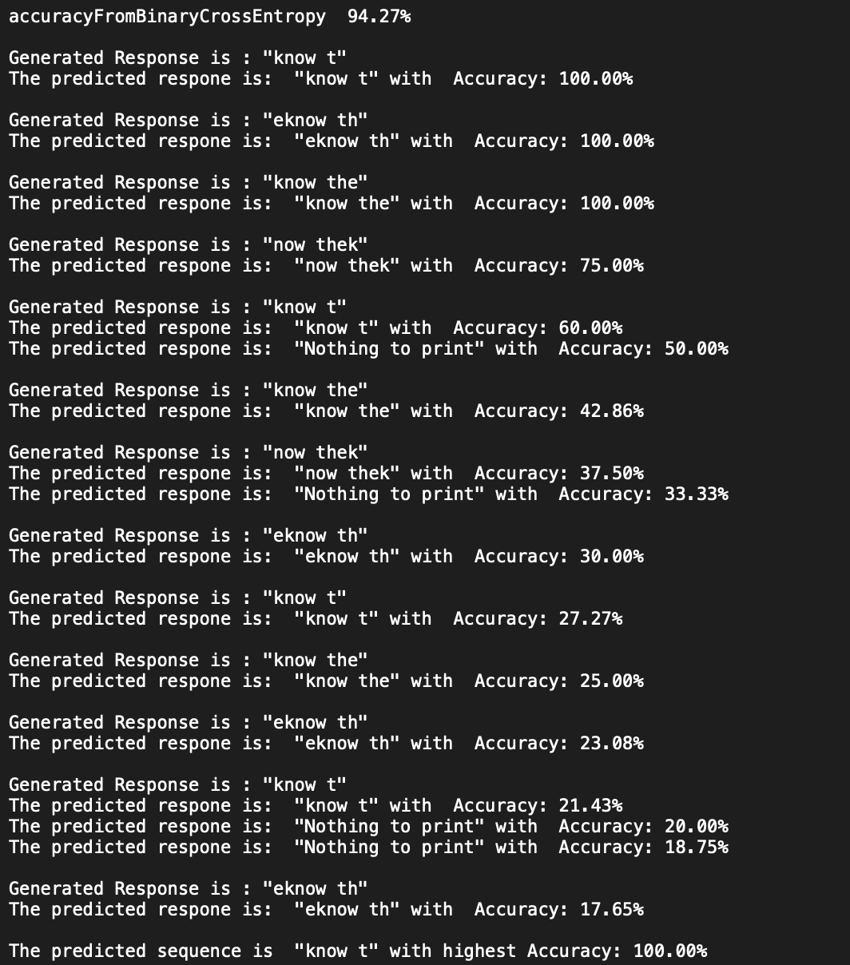
Results
Figure 3 : Prediction Accuracy
This model is trained on text datasets to accurately predict sequences. It emphasizes accuracy by selecting the sequence with the highest prediction accuracy, while also optimizing performance by using smaller dataset sizes to manage computational resources effectively.

Slide 14
Conclusion
The Neocortex API's multi-sequence learning, along with its language semantic extension, signifies a significant advancement in HTM algorithms applied to sequence learning and NLP tasks. Despite challenges such as handling long sequences, these programs excel in various tasks, including text analysis, ASCII conversion, iterative model training, prediction accuracy calculation, and binary cross-entropy loss during the training phase. Continued research is necessary to enhance the effectiveness of these tools for broader real-world applicability.

Slide 15
References
[1]Thasayu Soisoonthorn, H. Unger, and Maleerat Maliyaem, “Thai Word Segmentation with a Brain-Inspired Sparse Distributed Representations Learning Memory.,” vol. 2023, pp. 8592214–8592214, Jan. 2023, doi: https://doi.org/10.1155/2023/8592214.
[2]S. Purdy, “Encoding Data for HTM Systems.” Accessed: Apr. 07, 2024. [Online]. Available: https://arxiv.org/ftp/arxiv/papers/1602/1602.05925.pdf
[3]Y. Cui, S. Ahmad, and J. Hawkins, “The HTM Spatial Pooler—A Neocortical Algorithm for Online Sparse Distributed Coding,” Frontiers in Computational Neuroscience, vol. 11, Nov. 2017, doi: https://doi.org/10.3389/fncom.2017.00111.
[4]“Researchers develop an artificial neuron closely mimicking the characteristics of a biological neuron,” News Medical, Jan. 17, 2023. Available: https://www.news-medical.net/news/20230116/Researchers-develop-an-artificial-neuron-closely-mimicking-the-characteristics-of-a-biological-neuron.aspx
[5] Chen, X. and Wang, W. (2012). An overview of hierarchical temporal memory: A new neocortex algorithm. pages 1004–1010.
[6] Khan HM, Khan FM, K. A. A. M. A. D. (2021). Anomalous behavior detection framework using htm-based semantic folding technique. comput math methods med.

Slide 16
Thank You

